Slide 1


Trilok Chowdary
Program Manager
Codepixel

Slide 2

















































Slide 3
























































Slide 4




















Slide 5
















































A variety of real-world applications
Vision Speech Language Knowledge
Search
Natural Language Processing
Here are the top results:
Here is what I found:
Intent: PlayCall
Oct 28, 2015 – Here are FIVE key trends in 2014 that would help marketers in rolling ... Of late, marketers are looking at customer lifecycle management (CLM)
It also investigates the top three expected Fraud Detection and Prevention programs, in terms of demand in key markets…
The purpose of Customer Life-cycle Management (CLM) is to maximize both customer retention and .... Predictive trend analysis provides business visibility.
First, let’s point out that there is not one absolute answer—there are “pros” and “cons” to each. Those who favor in-house…
Jan 5, 2016 – The top 10 customer service trends for 2016 that .... North American Consumer
Michael heads fraud prevention tool. Online and mobile shopping are expected to continue growing apace…

Slide 6








Slide 7






Slide 8












Slide 9








Slide 10








Enrich user experiences with contextual entity search results

Slide 11








Slide 12



Slide 13









Slide 14
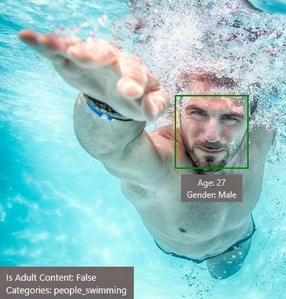


























Slide 15









Slide 16



















Slide 17




Slide 18










Slide 19






Slide 20



Slide 21







Slide 22
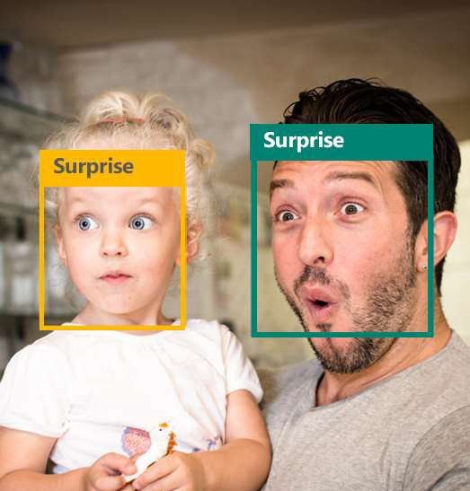













Slide 23






Slide 24












Slide 25






Slide 26







Slide 27





Slide 28



Slide 29







Slide 30







Slide 31








Slide 32






Slide 33

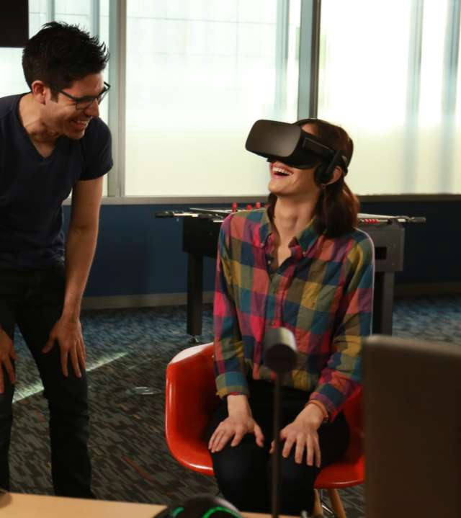




Slide 34






Slide 35
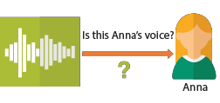



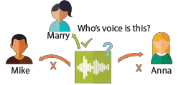






Slide 36




Slide 37












Slide 38

























Slide 39







Slide 40











Slide 41





























Language understanding models

Slide 42
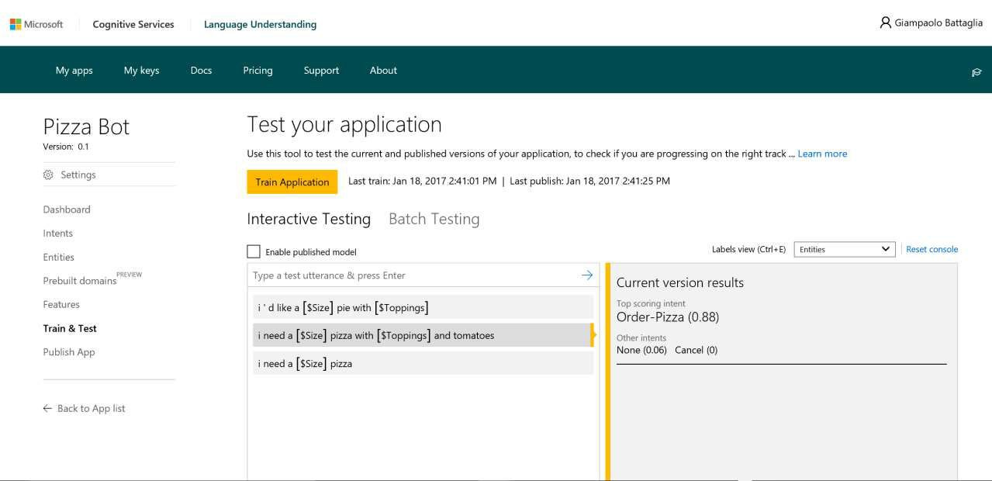

Slide 43









Slide 44

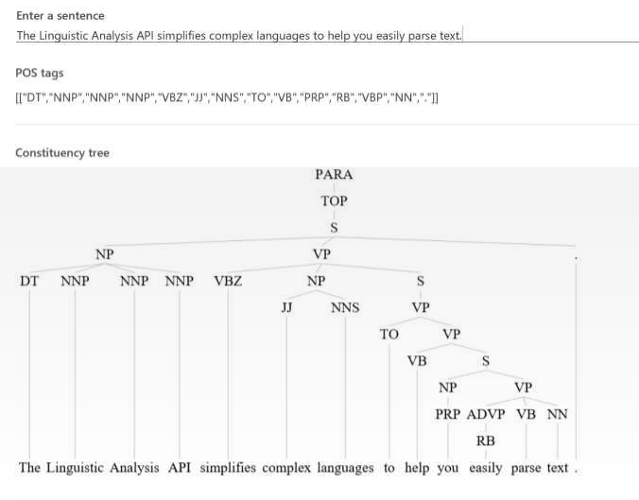

Slide 45







Slide 46








Slide 47







Slide 48




Slide 49










Slide 50






Slide 51








Slide 52





Slide 53




Slide 54




Slide 55








Slide 56












Slide 57







Slide 58




Slide 59



Slide 60





Slide 61





Slide 62




Slide 63





Slide 64

















Slide 65




Enrich user experiences with contextual entity search results
Tap into the power of the web to search for the most relevant entities (such as movies, books, famous people, U.S. local businesses…) and easily provide primary details and information sources about them
Augment your content with
entity search results
Showcase of local
businesses nearby

Slide 66




http://azure.com/Cognitive
website website

Slide 67























Slide 68








Resources, Tutorials & Demos
https://aka.ms/aicog https://aka.ms/cogsamples
https://aka.ms/face-cs https://aka.ms/face-jv
https://aka.ms/face-py
https://how-old.net/ https://www.celebslike.me
https://www.what-dog.net
https://aka.ms/tr yvision

Slide 69


